Slide 1
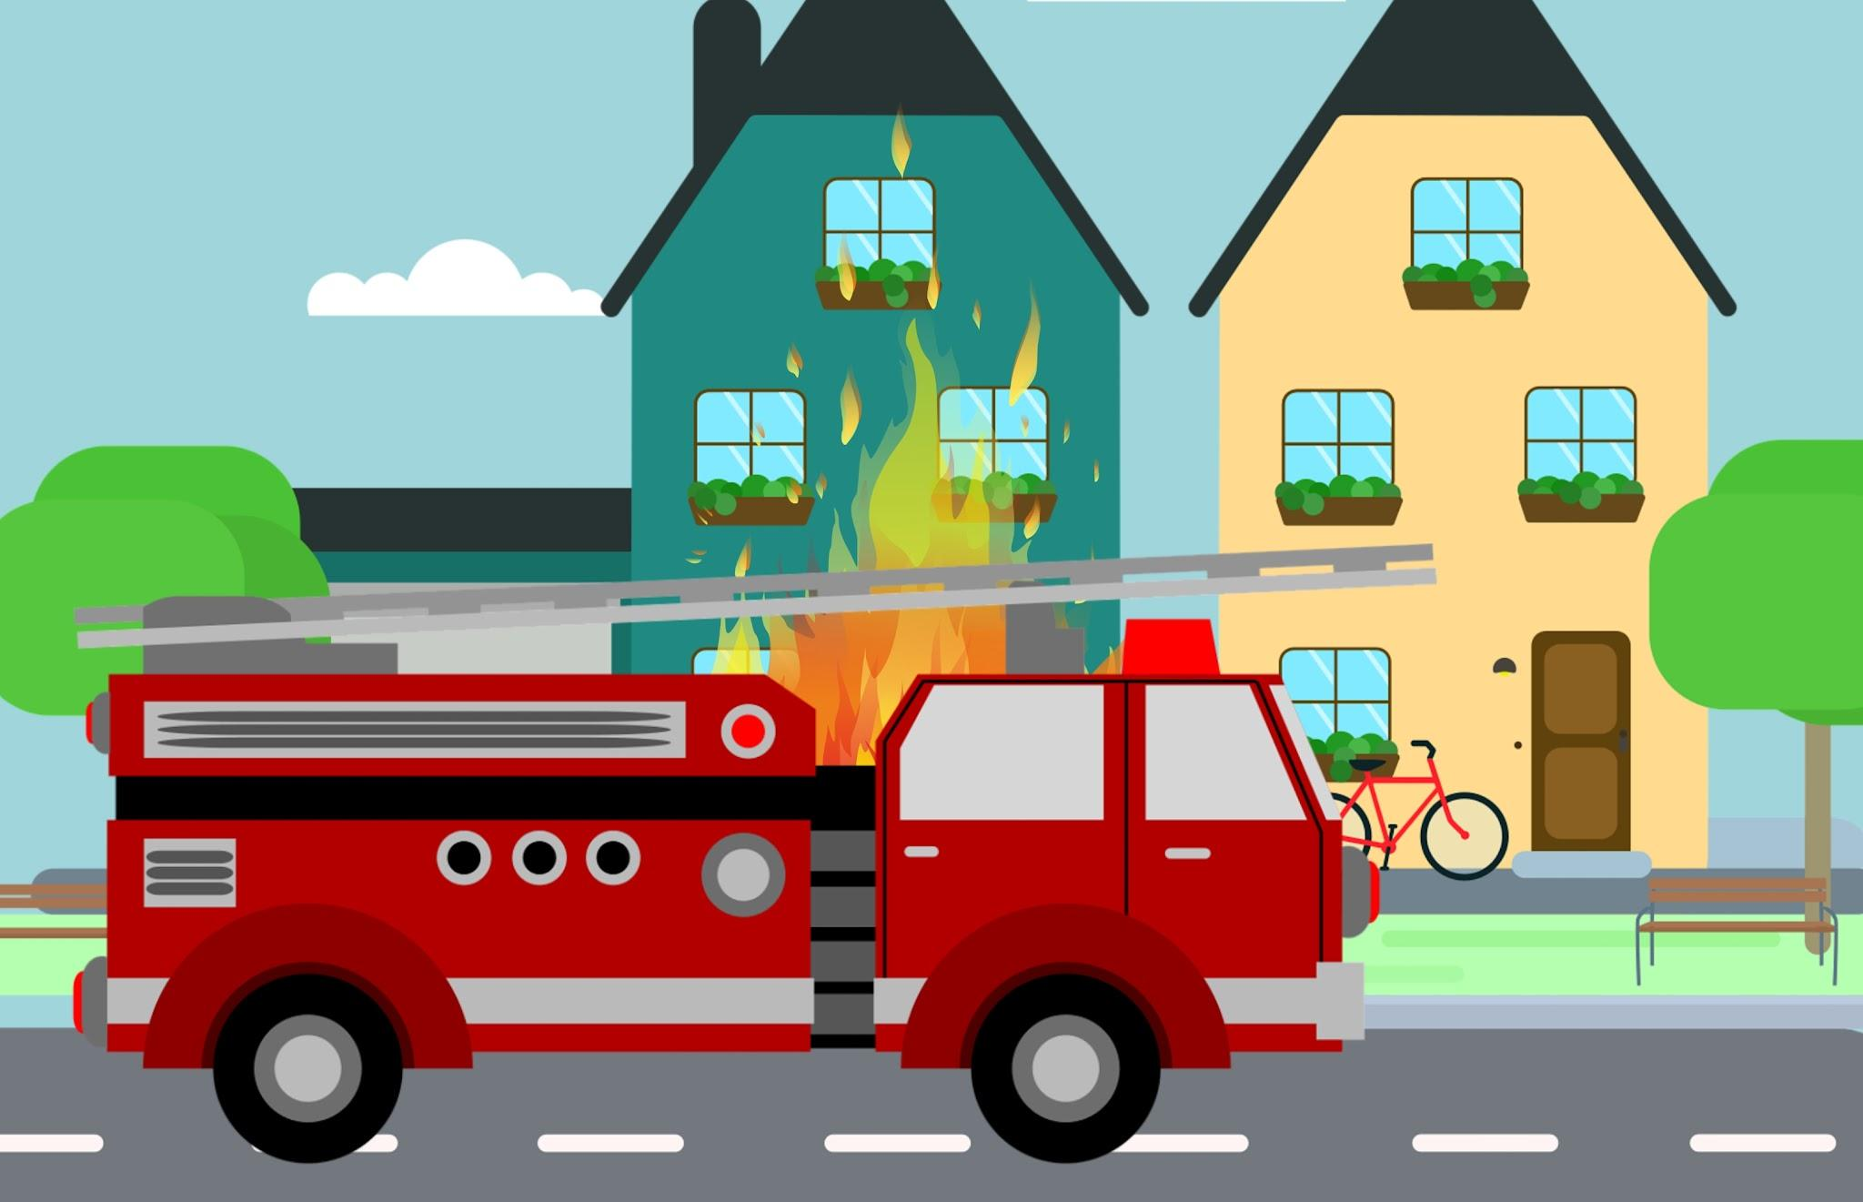
Personal, Social & Emotional Development
We will be…
- Learning how family and friends care for each other
-Learning how to ask when we need help from an adult or peer
-Talking about feelings
-Giving help or comfort to those who are upset
Physical Development
We will be…
-Learning to put on shoes and to pull zips up and down.
-Starting to use our finger and thumb (pincer grip) to hold a pencil/paintbrush to make marks.
-Learning how to brush our teeth with a little support
-Learning to ride a trike
-Hopping or standing on one foot for 5 seconds
Collective Worship theme: Respect
Pears Topic Web
Spring One 2026
Topic- I can help others & people who help me
Communication and language
We will be…
-Starting conversations with an adult or friend and continuing it
-Using some new vocabulary
-Listening to stories and remembering what has happened
-Talking about familiar books
-Learning to understand who, where and when question
Literacy
We will be…
-Learning bout words that rhyme
-Starting to recognise words with the same initial sound e.g. snake, sand, scissors
-Beginning to recognise our name
-Discussing stories
-Talking about things that have happened to us in the past, are happening now or will happen in the future
Spirituality
CONNECT – connecting through community
REFLECT – reflecting on how we can help
RESPECT – respecting everyone’s choices
Mathematics
We will be…
-Counting objects with 1-to-1 correspondence
-Beginning to estimate a small group of objects
-Subitising some number patterns instantly e.g. dice patterns
-Subitising numbers on fingers
-Identifying fewer when comparing 2 groups and using the language ‘fewer’
-Ordering groups of objects by how many there are - fewest to most
Understanding the World
We will be…
-Learning who is in our family and talking about members of our family
-Learning about different types of families
-Sequencing family members by size and name
-Learning about different types of materials
-Learning about occupations e.g. firefiighters, police officers
-Exploring how to make a bee-bot move
Expressive Arts and Design
We will be…
-Drawing pictures of ourselves and our families
-Identifying and matching an instrumental sound e.g. knowing it is a tambourine we can hear
-Telling stories using small world equipment e.g. play fire station and fire engines

