Slide 1
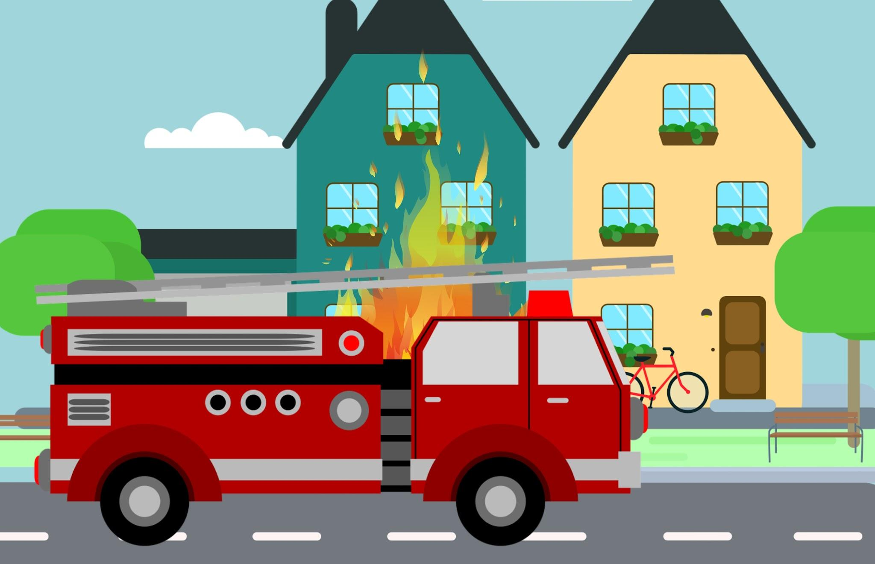
Personal, Social & Emotional Development
We will be…
-Making new friends
-Managing transitions e.g. from parent to key worker
-Learning and understanding some of the boundaries
-Identifying family members
-Developing our sense of belonging to a group
Collective Worship theme: Respect
Physical Development
We will be…
-Learning to move in different ways, using the outside space safely
-Using large-muscle movements to wave flags and streamers.
-Learning to take off own coat
Apples Topic Web
Spring One 2026
Topic- I help others & people who help me
Communication and language
We will be…
-Using social phrases e.g. hello, goodbye
-Listening to others talk
-Understanding ‘now’ and ‘next’
-Using talk in play
Literacy
We will be…
-Joining in with songs and nursery rhymes
-Learning new vocabulary
-Listening to stories
Spirituality
CONNECT – connecting through community
REFLECT – reflecting on how we can help
RESPECT – respecting everyone’s choices
Mathematics
We will be…
--Exploring different shapes through construction play indoor and outdoor
-Understanding important times of the day e.g lunchtime, hometime
-Counting in everyday contexts
Understanding the World
We will be…
-Learning who is in our family and talking about members of our family
-Learning about occupations e.g. firefiighters, police officers
-Repeating actions that have an effect
Expressive Arts and Design
We will be…
-Beginning to use a variety of tools such as paint and brushes
-Engaging in pretend play with others
-Using objects for printing

