Slide 1
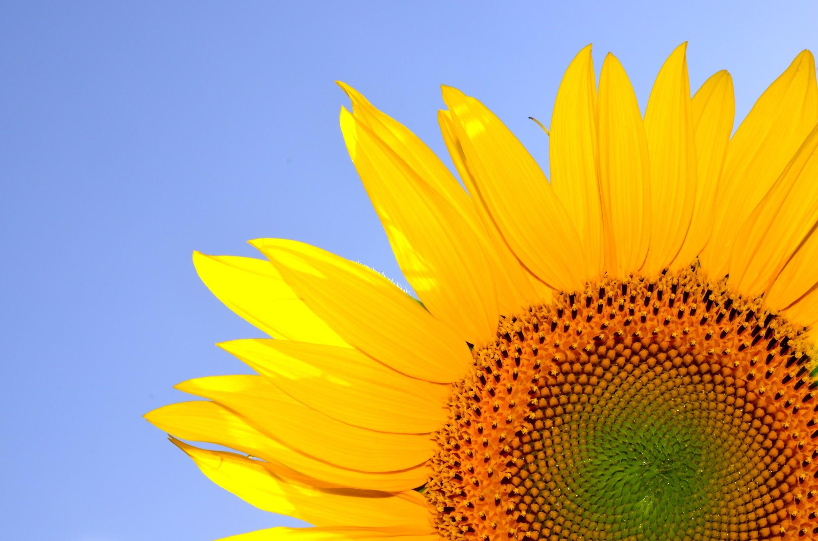
Collective Worship theme: Generosity
Physical Development
We will be…
-Learning to move in different ways, using the outside space safely
-Using large-muscle movements to wave flags and streamers.
-Learning to take off own coat
Personal, Social & Emotional Development
We will be…
-Learning and understanding some of the boundaries
-Learning how to share with friends
Apples Topic Web
Summer One 2026
Topic- I am growing
Communication and language
We will be…
-Using social phrases e.g. hello, goodbye
-Listening to others talk
-Understanding ‘now’ and ‘next’
-Linking 2 or more words together in talk
-Learning nursery rhymes
Literacy
We will be…
-Reading ‘Plant the Tiny Seed’, ‘Ten Seeds’, ‘Sam plants a flower pot’, ‘Grow it’, 'Orange Pear, Apple Bear', ‘Jasper’s Beanstalk’
-Joining in with songs and nursery rhymes
-Learning new vocabulary
Spirituality
CONNECT – connecting through nature
REFLECT – reflecting on how we treat living things
RESPECT – respecting our environment
Understanding the World
We will be…
-Noticing changes
-Learning about plants and how they grow
-Naming the simple parts of a plant
-Planting seeds, beans and flowers
Mathematics
We will be…
-Saying number words (in sequence)
-Exploring different shapes through construction play indoor and outdoor
-Understanding important times of the day e.g lunchtime, hometime
-Using vocabulary to compare size
Expressive Arts and Design
We will be…
-Beginning to use a variety of tools such as paint and brushes
-Engaging in pretend play with others
-Using objects for printing
-Playing musical instruments

