Slide 1
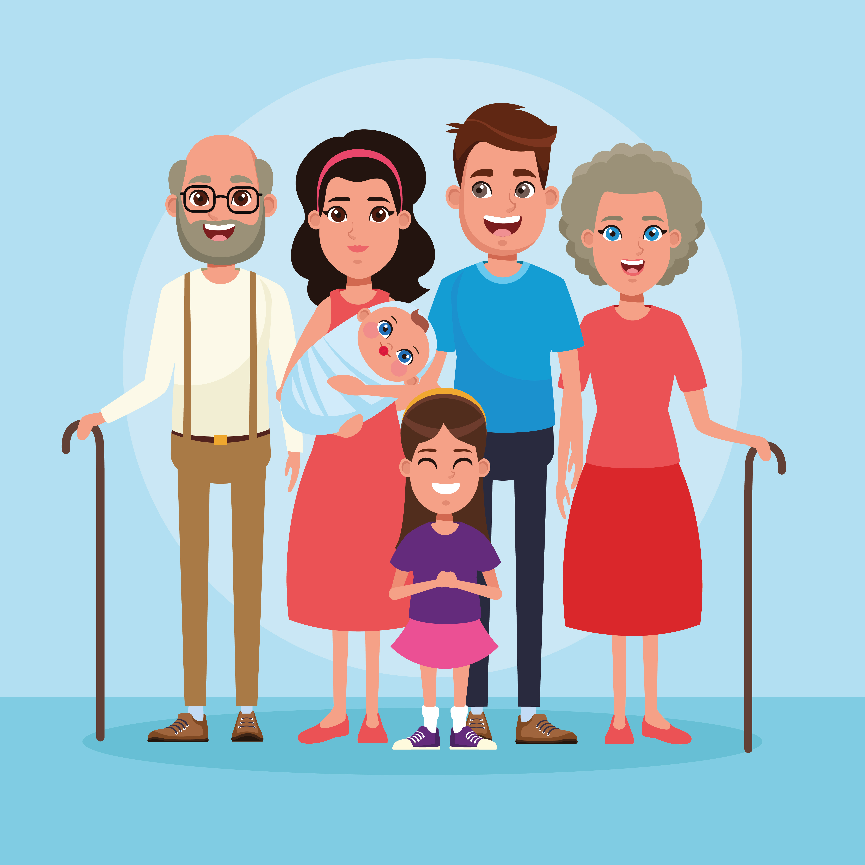
Religious Education
We will be…
-Reading bible stories
Collective worship value: Thankfulness
Apples Topic Web
Autumn One 2026
Topic- I am me!
Spirituality
CONNECT – connecting to each other
REFLECT – reflecting on how we can help each other
RESPECT – respecting everyone by listening to them
Personal, Social and Emotional Development
We will be…
-Happily leaving our caregiver
-Establishing a relationship with our Key Worker
-Recognising ourselves as part of the Apples’ community
-Choosing what we would like to play with
-Developing friendships with other children
-Enjoying singing, music and toys that make sounds
Literacy
We will be…
-Sharing books with adults
-Noticing print in the environment, such as logos
-Enjoying drawing
Mathematics
We will be…
-Joining in with simple number songs and rhymes
-Saying some number names in sequence
-Comparing amounts using ‘lots’, ‘more’, ‘same’
-Completing inset puzzles
-Building with a range of resources
Communication and language
We will be…
-Starting to develop conversation
-Using a wider range of vocabulary
-Starting to join in with singing familiar nursery rhymes
-Listening and responding to simple instructions
Understanding the World
We will be…
-Noticing similarities and differences in people
-Thinking and talking about our families and homes
Expressive Arts and Design
We will be…
-Joining in with singing familiar nursery rhymes
-Taking part in simple pretend play
-Moving and dancing to music.
-Starting to make marks intentionally.
-Exploring paint, using fingers and other parts of our bodies as well as brushes and other tools.
Physical Development
We will be…
-Enjoying moving when outside and inside
-Building with a range of resources
-Becoming more independent

